Slide 1
SUPERMARKET MANAGEMENT SYSTEM DATABASE MANAGEMENT SYSTEM

Slide 2
TEAM MEMBERS BHAVESH RUGHWANI -16BCP040 SMIT SANGHAVI -16BCP044 JIGAR SHAH -16BCP047 SUPRAGYA LAL -16BCP054 TIRTH PATEL -16BCP056

Slide 3
Acknowledgement
We have taken efforts in this project. However, it would not have been possible without the kind support and help of many individuals and organizations. I would like to extend my sincere thanks to all of them.
We are highly indebted to Sir Nishant Doshi for his guidance and constant supervision as well as for providing necessary information regarding the project & also for their support in completing the project.
We would like to express my gratitude towards my parents & member of Pandit Deendayal Petroleum University for their kind co-operation and encouragement which help me in completion of this project.
Our thanks and appreciations also go to our colleagues who have helped in developing the project and the people who have willingly helped us out with their abilities.

Slide 4
Introduction
The project “Supermarket Management System” provides us simple interface for maintenance of information related to supermarket. This system can be used by supermarket to maintain the records . Throughout the project our focus has been on presenting information in an easy and intelligible manner.
We have used various concepts of relational database to store it more efficiently as well as provide various advantages of relational database such as: Data Isolation, Data Integrity, Security Constraints, Atomicity and Concurrent access of data.

Slide 5
EXPERIMENT 1
ADVANTAGE OF DATABASE MANAGEMENT SYSTEM OVER FILE PROCESSING SYSTEM

Slide 6
CONCURRENT ACCESS ANOMALIES
It basically means that two different users try to access a particular database and try to make changes in it according to their requirement.
In a gist , In the context of supermarket, concurrent access anomalies may have this problem.
Suppose we have a section of super market which stores stationary items.
Here , We are enlisting details about stock of n books
In the table given below , as we can see that there are two customers who are buying the same product.
But as after ,the book being sold to the customer id145296 so at that same time the book cannot be sold to any other customer with any other customer id.

Slide 7
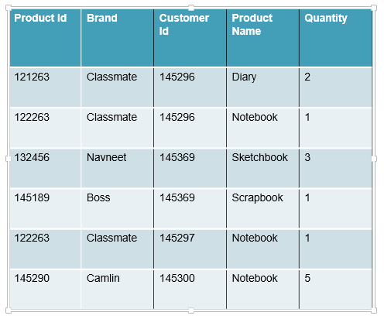

Slide 8
DATA ISOLATION
Because data are scattered in various ﬁles, and ﬁles may be in different formats, writing new application programs to retrieve the appropriate data is difficult.
A lower isolation level increases the ability of many users to access the same data at the same time ,but increase the number of concurrency effects (such as dirty reads or lost updates) users might encounter.
Conversely, a higher isolation level reduces the types of concurrency effects that users may encounter, but requires more system resources and increases the chances that one transaction will block another.
For example , in context to supermarket, when a user is creating a purchase order and has created the header ,but not the purchase order lines, is the header available for other systems/users ,carrying out concurrent operations (such as a report on purchase orders), to see?

Slide 9
INTEGRITY PROBLEMS
The data values stored in the database must satisfy certain types of consistency constraints.
Suppose the university maintains an account for each department, and records the balance amount in each account.
Suppose also that the university requires that the account balance of a department may never fall below zero.
Developers enforce these constraints in the system by adding appropriate code in the various application programs.
However, when new constraints are added, it is difficult to change the programs to enforce them.
The problem is compounded when constraints involve several data items from different ﬁles.
An example being textual data entered where a date-time value is required. Rules for data derivation are also applicable, specifying how a data value is derived based on algorithm, contributors and conditions. It also specifies the conditions on how the data value could be re-derived.

Slide 10
In a Super Market, when one is preparing the bill, the same time inventory record will be updated, so data integrity provides access but data will be allowed to change as per algorithm only, other can access but cannot change.

Slide 11
DIFFICULTY IN ACCESSING DATA
When there is very huge amount of data, it is always a time consuming task to search for particular information from the file system.
Conventional file-processing environments so not allow needed data to be retrieved in a convenient and efficient manner
In classical file organization the data is stored in files.
Whenever data has to be retrieved as per requirements, a new application program has to be written which, is a very tedious process.
Consider following table. In, File system if one wants to find ID of costumer who bought a product of class mate then we need to ask programmer to make an application which can fulfill our purpose or extract information manually
Both of these alternatives are time consuming
Further, if we want to find some other information like product ID of products of Classmate brand then we have to again ask the programmer to write the application program or extract information manually.
Both these ways are quite tedious.

Slide 12
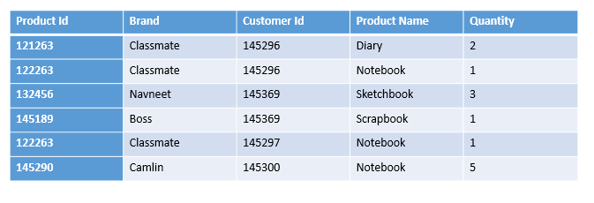

Slide 13
SECURITY PROBLEMS
Data security means prevention of data accession by unauthorized users.
Every user of database system should not be allowed to access all the data
There is no centralized control of data in classical file organization.
Moreover, application programs are added to file-processing system in an ad hoc manner, enforcing security constraints is difficult.
Here,in context to supermarket store, if all users are allowed to access all data then, there are chances of data getting altered which can create a problem.

Slide 14
ATOMICITY PROBLEMS
Atomicity is the first stage of the ACID model (Atomicity, Consistency, Isolation, Durability), which is a set of guidelines for ensuring the accuracy of database transactions.
Either all operations of the transaction are reflected properly in the database, or none are.
If all the operations are executed successfully,then the entire transaction should be saved to the database
It is essential that a database system that claims to offer atomicity be able to do so even in the face of failure in power supply or the underlying operating system or application that uses the database.
Suppose we have a section of super market which stores stationary items.
Here , We are enlisting details about stock of n books.
So, basically the table gives the information about the things which the customer have bought it’s quantity etc.

Slide 15
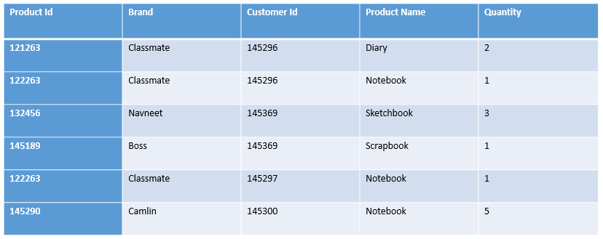
In the table given, the seller updates the stock so that he can keep a track of products to be bought. But now if we write two statements in any database(say MySQL) to first update the CUSTOMER_STATIONARY TABLE and then update the SELLER_STATIONARY TABLE, then this transaction should be completed fully or should not take place.

Slide 16
DATA REDUNDANCY AND INCONSISTENCY
Since different programmers create the files and application programs over a long period, the various files are likely to have different structures and the programs may be written in several programming languages.
Moreover, the same information may be duplicated in several places
It may lead to data inconsistency. That is, the various copies of the same data may no longer agree.
For example in context to supermarket, if there is a list of customers in two different shops then in file system there are chances that both these shops reflect different customer ID for same customer.

Slide 17
EXPERIMENT 2
RELATIONAL MODEL

Slide 18
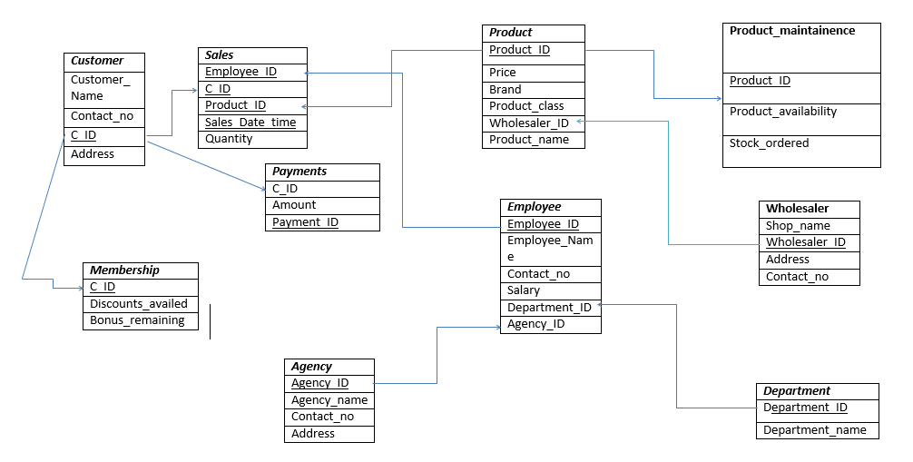

Slide 19
EXPERIMENT 3
OPERATORS USED IN RELATIONAL ALGEBRA
And relational algebra queries

Slide 20
16BCP040
1.SELECTION(σ)-select name RAGHU from the EMPLOYEE table
σname=”RAGHU”(EMPLOYEE)
2.PROJECTION(π) –project product id and brand from the Product table
Πproduct_id,brand(Product)
3.UNION(U)-select C. ID from customer and Union with product id from product
ΠC_ ID(CUSTOMER) U ΠProduct_ID(Product)
4.CARTESIAN PRODUCT(×) –select names where name=’Ramesh’ from the cartesian product table employee and customer
σname=’Ramesh’ (EMPLOYEE× CUSTOMER)
5.NATURAL JOIN (⋈)– natural join of SALES and CUSTOMER
ΠC_ID (SALES ⋈ CUSTOMER)
6.SET DIFFERENCE( - )-select tuples from EMPLOYEE that are not present in CUSTOMER
Π department_ID(DEPARTMENT)-Πdepartment_ID(EMPLOYEE)
7.composition of two form-project customer id and address of customers who bought something
ΠC_ID(SALES ⋈ CUSTOMER)
8.composition of three form-project product id and class of products with brand name puma which are sold
ΠProduct Id,Product class (σBRAND=’PUMA’ (SALES ⋈ PRODUCT))

Slide 21
16BCP056
1.SELECTION(σ)-select customer id 102011 from the CUSTOMER table
σ_{C_ID}=102011(CUSTOMER)
2.PROJECTION(π) –project customer id and Address from the CUSTOMER table
ΠC_ID,Address(CUSTOMER)
3.UNION(U)-select account no from customer and Union with salary table from employee
Π_{Contact_no}(CUSTOMER) U Πsalary(EMPLOYEE) 4.CARTESIAN PRODUCT(×) –select salary less than 10k from the join table employee and SALES
σsalary<10k(EMPLOYEE× SALES)
5.NATURAL JOIN (⋈)– project employee_ID from natural join of EMPLOYEE and CUSTOMER
ΠEmployee_ID (EMPLOYEE ⋈ SALES)
6.SET DIFFERENCE( - ) :Find tuples present in Employee but not in customer table
ΠWholesaler_ID( WHOLSALER)- Π department_ID( PRODUCT)
7.composition of two form:project customer id and address of employee who sold something
Π_{employee_ID},Address(EMPLOYEE ⋈ SALES)
8.composition of three form:project employee id and phone no of employees who has
salary greater than 10000 and sold something
Π_{employee_ID},Contact_ no (σsalary>10k(EMPLOYEE⋈SALES))

Slide 22
16BCP047
1.SELECTION(σ)-select wholesaler with contact_no=9876564709 from the store table
σcontact_no=9876564709(WHOLESALER)
2.PROJECTION(π) –project product_id and sales_date from the sales table
Π_{product_id},Sales_date(SALES)
3.UNION(U)-select Payment_ID from Payments and Union with C_ID from customer table
Π_{C_ID}(CUSTOMER) U Π_{Payment_ID}(PAYMENTS)
4.CARTESIAN PRODUCT(×) –select salary less than 50k from the join table employee and customer
σsalary<50k(CUSTOMER× EMPLOYEE)
5.NATURAL JOIN (⋈)– natural join of STORE and CUSTOMER
STORE ⋈ CUSTOMER
6.SET DIFFERENCE( - ) :Tuples present in product but not in sales table
Πproduct_ID(PRODUCT)-Πproduct_ID(SALES)
7.composition of two form:project customer name and product_ID of product sold to customers
Πcustomer_name,product_ID(SALES⋈CUSTOMER)
8.composition of three form:project name and salary of employee named raj who sold something
Π_{employee_name,}salary (σname=RAJ(EMPLOYEE⋈SALES))

Slide 23
16BCP044
1.SELECTION(σ)-select Department_name=“security from the department table
σ Department_name=“Security” (DEPARTMENT)
2.PROJECTION(π) –Project agency_name and agency_ID from agency table
Πagency_name,agency_ID(AGENCY)
3.UNION(U)-select product id from Product and Union with Customer_ID from customer table
Πproduct_ID(SALES) U Π_{C_ID}(CUSTOMER)
4.CARTESIAN PRODUCT(×) –select name=’Ram’ from the Cartesian product of table employee and customer
σName=’Ram’(CUSTOMER× SALES)
5.NATURAL JOIN (⋈)– project employee_ID from natural join of PRODUCT and CUSTOMER
Πemployee_ID(AGENCY ⋈EMPLOYEE)
6.SET DIFFERENCE( - ):tuples present in agency but not in employee table
Πagency_ID(AGENCY)-Πagency_ID(EMPLOYEE)
7.composition of two form:customer name and address of customers who bought some product.
Πcustomer name,address(SALES⋈ CUSTOMER)
8.composition of three form:select and project salary of employees who sold something
and have salary equal to 15000
Πsalary (σsalary=15000(EMPLOYEE⋈SALES))

Slide 24
16BCP054
1.SELECTION(σ)-select salary greater than 5000 from the employee table
σ salary>5000 (employee)
2.PROJECTION(π) –project emp_ID and salary from the employee table
Πemployee_ID,salary(Empoyee)
3.UNION(U)-select phone no. from Employee and Union with product_id from sales table
ΠContact_n(Customer) U Π_{product_id}(sales)
4.CARTESIAN PRODUCT(×) – join table sales and customer
CUSTOMER× SALES
5.NATURAL JOIN (⋈)–project brand from natural join of PRODUCT and CUSTOMER
Πbrand(PRODUCT ⋈ SALES)
6.SET DIFFERENCE( - ) :Tuples present in department table but not in employee table
Πproduct_ID(PRODUCT)-Πproduct_ID(PRODUCT_MAINTAINENCE)
7.composition of two form:project wholesaler_ID of wholesaler from whom stock was bought
Π_{Wholesaler_ID}(WHOLESALER ⋈PRODUCT )
8.composition of three form:select and project phone no of employees allocated a department
Πphone no. (σphone no.(EMPLOYEE⋈DEPARTMENT))

Slide 25
EXPERIMENT 4
ER-MODEL

Slide 26
Tables
Product(Product_ID, Product_Name, Brand, Product_class, Price)
Employee(Employee_ID, Employee_name, Contact_no, Salary)
Customer(C_ID, Customer_name, Contact_no, Address)
Sales(C_ID, Employee_ID, Product_ID, Sales_Date_time, Quantity)
Payments(Payment_ID,Amount,C_ID)
Agency(Agency_ID,Agency_name,Contact_no,Address)
Wholesaler(Wholesaler_ID,Shop_name,Address,Contact_no)
Department(Department_ID,Department_Name)
Product_maintainence(Product_ID,Product_availability,Stock_ordered)
Membership(C_ID,Discounts_availed,Bonus_remaining)

Slide 27
KEYS
Super Keys:-
Employee
(i)(Employee_ID)
(ii)(Employee_ID, Contact_no)
(iii)(Employee_ID, Employee_name, Contact_no)
Product
(i)(Product_ID)
(ii)(Product_ID, Brand, Product_class)
(iii)(Product_ID, Product_Name, Brand, Product_Class)
Customer
(i)(C_ID)
(ii)(C_ID, Contact_no)
(iii)(C_ID, Name, Contact_no)
Sales
(i)(Sales_Date_time,C_ID, Product_ID,Employee_ ID)
Wholesaler
(i)(Wholesaler_ID,contact_no)
(ii)(Wholesaler_id,Contact_no,Shop_name)
Product_maintainence Product_ID
(Product_ID,Discounts_avaied)
Payments
(i)Payment_id
(ii)(Payment_id,C_ID)

Slide 28
Membership_Account
(i)(C_ID,Discounts_availed)
(ii)(C_ID,Discounts_availed,Bonus_remaining)
(iii)(C_ID)
Department
(i)(Department_name,Department_ID)
(ii)Department_name
Agency
(i)(Agency_ID,Agency_name,Contact_no)
(ii)Agency_ID
(iii)(Agency_ID,Agency_name)

Slide 29
KEYS
Candidate Keys:-
Employee
(Employee_ID)
Product
(Product_ID)
Customer
(C_ID)
Sales
(Sales_Date_time,C_ID, Product_ID,Employee_ ID)
Wholesaler
(Wholesaler_ID)
Payments
(i)(Payment_ID)
(ii)(C_ID)
Membership_Account
(i)(C_ID)
Department
(i)(Department_ID)
(ii)(Department_name)
Agency
(i)(Agency_ID)
Product_maintainence Product_ID

Slide 30
KEYS
Primary Keys: -
Employee
(Employee_ID)
Product
(Product_ID)
Customer
(C_ID)
Sales
(Sales_Date_time,C_ID, Product_ID, Employee_ ID)
Wholesaler
(Wholesaler_ID)
Payments
(Payment_ID)
Membership_Account
(C_ID)
Department
(Department_name)
Agency
(Agency_ID)
Product_maintainence Product_ID

Slide 31
Foreign Keys: -
Employee
Department_ID
Agency_ID
Product
Wholesaler_ID
Customer
No foreign keys
Wholesaler
No foreign keys
Payments
C_ID
Membership_Account
C_ ID
Department
No foreign Keys
Agency
No foreign Keys
Sales
C_ID
Employee_ID
Product_ID
Sales_Date
Product_maintainence Product_ID

Slide 32
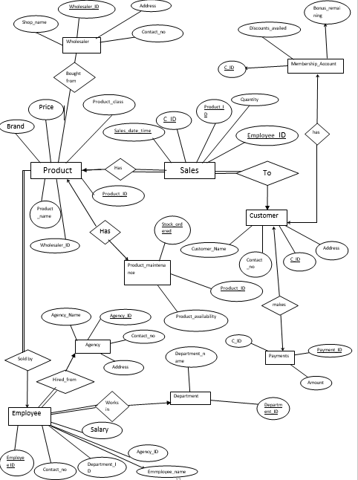

Slide 33
EXPERIMENT 5
INSTALLATION OF SQL

Slide 34
Installation performed in respective labs

Slide 35
EXPERIMENT 6
EXPLANATION OF
-DDL -SQL
-DML -KEYS
-DCL

Slide 36
What is sql?
SQL stands for Structured Query Language
IBM developed the original version of SQL, originally called Sequel, as part of the system R project in the early 1970s
SQL lets you define and manipulate databases

Slide 37
What is DDL?
DDL is stands for Data Definition Language
DDL provides commands for- :
Defining relation schemas,
deleting relations
modifying relation schemas.

Slide 38
What is DML?
DML is short name of Data Manipulation Language
The SQL DML provides the ability to
Query information from the database
Insert tuples
Delete tuples
Modify tuples in the database.
There are basically two types:
• Procedural DMLs require a user to specify what data are needed and how to get those data.
• Declarative DMLs (also referred to as nonprocedural DMLs) require a user tospecify what data are needed without specifying how to get those data.

Slide 39
What is DCL?
A data control language (DCL) is a syntax similar to a computer programming language used to control access to data stored in a database . In particular, it is a component of Structured Query Language (SQL).
Examples of DCL commands include:
GRANT to allow specified users to perform specified tasks.
REVOKE to cancel previously granted or denied permissions.

Slide 40
Keys
Let R denote the set of attributes in the schema of relation r. If we say that a subset K of R is a superkey for r , we are restricting consideration to instances of relations r in which no two distinct tuples have the same values on all attributes in K. That is, if t1 and t2 are in r and t1 = t2, then t1.K = t2.K.
If K is a superkey, then so is any superset of K. We are often interested in superkeys for which no proper subset is a superkey. Such minimal superkeys are called candidate keys.
We shall use the term primary key to denote a candidate key that is chosen
by the database designer as the principal means of identifying tuples within a
relation.
A relation, say r1, may include among its attributes the primary key of another
relation, say r2. This attribute is called a foreign key from r1, referencing r2.
The relation r1 is also called the referencing relation of the foreign key dependency,
and r2 is called the referenced relation of the foreign key.

Slide 41
Experiment 7
AGGREGATE FUNCTIONS AND QUERIES

Slide 42
Aggregate function queries
1) Find average salary of employees in each department--query
select avg(salary) as avg_sal
from Department_ID
group by Department_ID
2)Find department with average salary greater then 20000--query
select department_name, avg (salary) as avg salary
from Department
group by department_name
having avg (salary) > 20000;

Slide 43
Experiment 8
Set operations, Sub-queries, Correlated sub-queries in
SQL

Slide 44
1)Product_ID for which Payment_ID is C11829
select Product_id
from sales
where
C_ID=(select C_ID
from payments
where payment_id='C11829');
2)Retrieve names and ids of employees who are not in cashier and cleaning department
select employee_id,employee_name
from employee
where department_id is not in (select department_id
from department where department='Cashier' and department='Cleaning'

Slide 45
Experiment 9
Use of group by, Having, Order by features of SQL

Slide 46
Queries
1)Display name and contact no. of employees in each department whose salary is less than 5000
select name, contact_no
from employee
group by department_id
having salary<5000;
2)Display customer name in alphabetical order who bought product with product_id=10838
select customer_name
from customer natural join sales
where product_id=10838 order by customer_name;

Slide 47
Experiment 10
Different types of Join operations, Exist, Any, All and relevant features of
SQL

Slide 48
Exist
1)return true and list department name which has employee who has salary less then 90k
SELECT department_name
FROM department
WHERE EXISTS (select employee_id from employee where
department_id=department.department_id and salary < 90000)
2)return true and list customer name who pays > 10000
select customer_name
from customer
where exist (select payment_id from payments where c_id=customer.c_id and amount > 10000)

Slide 49
Any
1)RETURN TRUE AND LIST product name which has availibility
SELECT Product_Name
FROM Product
WHERE Product_ID = ANY (SELECT Product_ID FROM product_maintenance WHERE product_availability =‘YES’)
2)list customer name who availed discount
SELECT CUSTOMER_NAME
FROM CUSTOMER
WHERE C_ID=ANY(SELECT C_ID FROM maintenance WHERE discounts_availed > 5)

Slide 50
ALL
2)list department name which HAS ALL employee HAVE SALARY greater THEN 20000
select department_name
from department
where department_id=ALL(select department_id from employee where salary > 20000)
1) list product name which sold after 20 march 2014
select product_name
from product
where product_id=ALL(select product_id from sales where sales_date = 2014-3-14)

Slide 51
Experiment 11
Implement different types of Views

Slide 52
Views
Whats view?
In database, a view is the result set of a stored query on the data, which the database users can query just as they would in a persistent database collection object. This pre-established query command is kept in the database dictionary. Unlike ordinary base tables in a relational database, a view does not form part of the physical schema: as a result set, it is a virtual table computed or collated dynamically from data in the database when access to that view is requested. Changes applied to the data in a relevant underlying table are reflected in the data shown in subsequent invocations of the view.

Slide 53
Queries
1.create a view to show all employees in deartment of security
Create view security as
Select employee_ID,Employee_name
From employee natural join dpartment
Where department_name=“Security”
2.create a view to show all wholesalers who sell products with product class electronics
Create view electronics_wholesalers as
Select wholesaler_name,Contact_no
From wholesaler natural join product
Where product_class=“Electronics”

Slide 54
3.Create a view to show membership of all customers who brought something on date 3-10-2017
Create view cleaning_department as
Select M.C_ID,M.discounts_availed,M.bonus_remaining
From (Sales natural join customer)natural join membership as m
Where Sales_date_time=2017-10-03

Slide 55
Experiment 12
Use of Transaction control commands, Commit, Rollback, Save point features of SQL

Slide 56
Commands
Commit command
Commit command is used to permanently save any transaction into database.
Following is Commit command's syntax,
Commit;
Rollback command
This command restores the database to last commited state. It is also use with savepoint command to jump to a savepoint in a transaction.
Following is Rollback command's syntax,
Rollback to< savepoint-name>;
Savepoint command
savepoint command is used to temporarily save a transaction so that you can rollback to that point whenever necessary.
Following is savepoint command's syntax,
Savepoint<savepoint-name>;

Slide 57
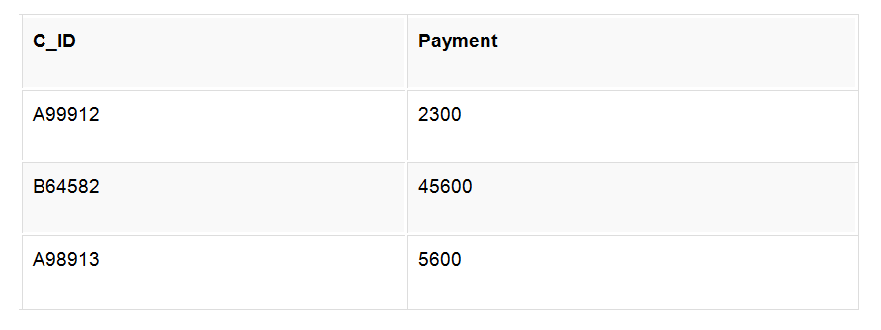
INSERT into Payments values(A93693,10000);
commit;
UPDATE payments set C_ID=A93682 where payment is 10000;
savepoint A;
INSERT into Payments values(A94682,2200);
savepoint B;
INSERT into Payments values(A95582,12200);
savepointC;
INSERT into Payments values(A94692,21200);
Following is the Payments table

Slide 58
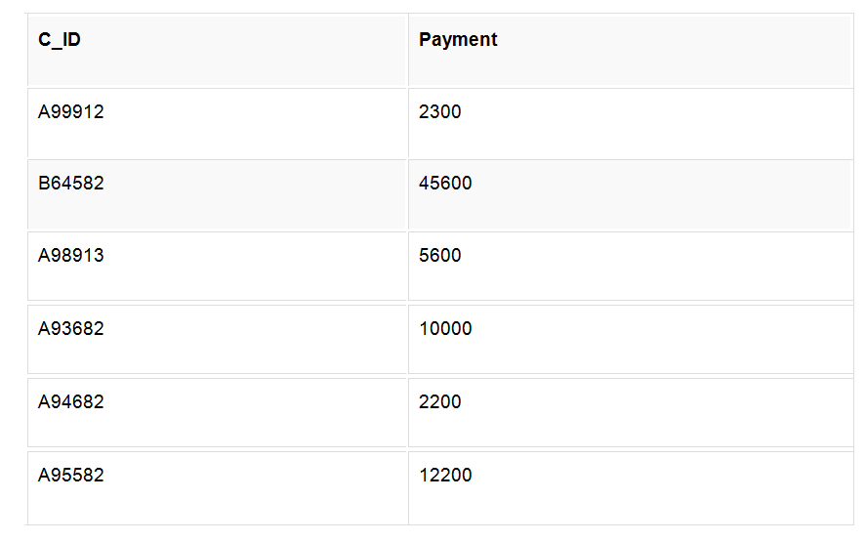
The resultant table will look like,

Slide 59
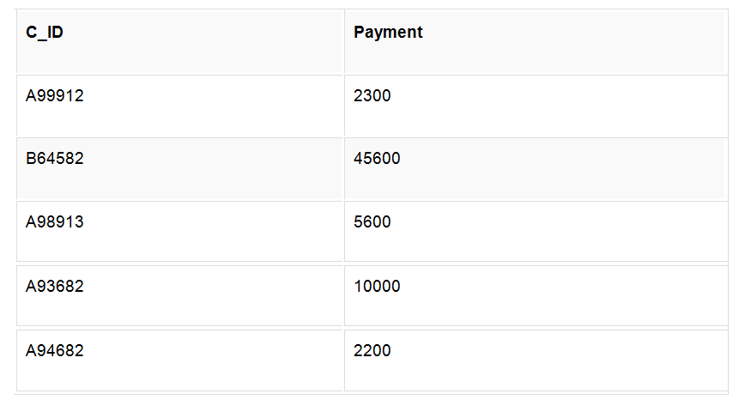
Now rollback to savepoint B
rollback to B;
SELECT * from class; The following will be the resultant table

Slide 60
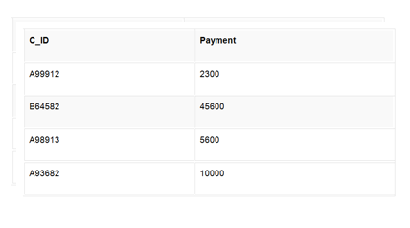
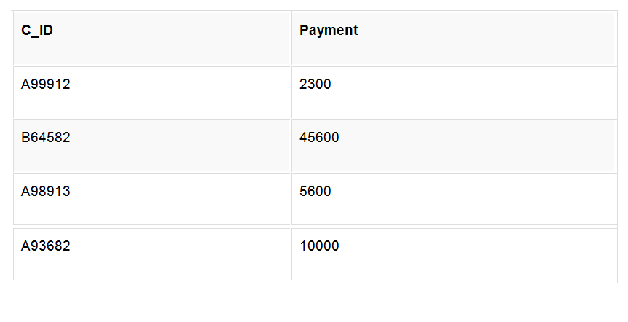
Now rollback to savepoint A
rollback to A;
SELECT * from class; Below is the resultant table

Slide 61
Experiment 13
Database Normalization

Slide 62
Functional Dependencies
Table Customer:
C_ID →Customer_name,Contact_no,Address
Minimal Cover
C_ID →Customer_name
C_ID →Address
C_ID →Contact_no
BCNF form
Candidate key-C_ID
Table Sales
C_ID,Product_ID,Employee_ID,Sales_Date_time→Quantity
Minimal cover
C_ID,Product_ID,Employee_ID,Sales_Date_time→Quantity
BCNF form
Candidate key-C_ID,Product_ID,Employee_ID,Sales_Date

Slide 63
Membership Table
C_ID→discounts_availed,Bonus_remaining
Minimal cover
C_ID→Bonus_remaining
C_ID→discounts_availed
BCNF form
Candidate key-C_ID
Payments Table
Payment_ID→C_ID,amount
Minimal cover
Payment_ID→C_ID
Payment_ID→amount
BCNF form
candidate key-Payment_ID

Slide 64
Agency Table
Agency__ID→agency_name,Contact_no,Address
Minimal cover
Agency__ID→agency_name
Agency__ID→Contact_no
Agency__ID→Address
BCNF form
Candidate key-Agency_ID
Employee Table
Employee_ID→Emplouee_name,Contact_no,Salary,Agency_ID,Department_ID
Minimal cover
Employee_ID→Contact_no
Employee_ID→Salary
Employee_ID→Agency_ID
Employee_ID→Department_ID
Employee_ID→Employee_name
BCNF form
Candidate key-Empoyee_ID

Slide 65
Product Table
Product_ID→price, brand,product_class,wholesaler_ID,product_name
Minimal cover
Product_ID→product_name
Product_ID→wholesaler_ID
Product_ID→product_class
Product_ID→ brand
Product_ID→price,
BCNF form
Candidate key-Product_ID
Product_maintainence Table
Product_ID→Product_availability,stock_ordered
Minimal cover
Product_ID→stock_ordered
Product_ID→Product_availability
BCNF form
Candidate key-Product_ID

Slide 66
Wholesaler Table
Wholesaler_ID→Shop_name,Contact_no,Address
Minimal cover
Wholesaler_ID→Contact_no
Wholesaler_ID→Address
Wholesaler_ID→Shop_name
BCNF form
Candidate key-Wholesaler_ID
Department Table
Department_ID→Department_name
Department_name→deartment_ID
BCNF form
Candidate key-department_name,Department_ID

Slide 67
Experiment 14
Introduction to Embedded SQL, PL SQL Concepts

Slide 68
What is Embedded SQL?
As a result, database applications are usually developed by combining capabilities of a high-level programming language with SQL.
The simplest approach is to embed SQL statements directly into the source code file(s) that will be used to create an application. This technique is referred to as embedded SQL programming.
sqlca.h – header file to be included.

Slide 69
Embedded SQL
High-level programming language compilers cannot interpret, SQL statements.
Hence , source code files containing Embedded SQL must be preprocessed before compiling.
Thus each SQL statement coded in a high-level programming language source code file must be prefixed with the keywords EXEC SQL and terminated with either a semicolon or the keywords END_EXEC.

Slide 70
Embedded SQL
Likewise, the Database Manager cannot work directly with high-level programming language variables.
Instead, it must use special variables known as host variables to move data between an application and a database.
Two types of Host variables:-
Input Host Variables – Transfer data to database
Output Host Variables – receives data from database

Slide 71
Embedded SQL
Host variables are ordinary programming language variables.
To be set apart, they must be defined within a special section known as a declare section.
EXEC SQL BEGIN DECLARE SECTION
Char Employee_id[7]
Double salary;
EXEC SQL END DECLARE SECTION
Each host variable must be assigned a unique name even though declared in different declaration section.

Slide 72
Experiment 15
Implementation of Cursors, Stored Procedures, Stored Function, Triggers

Slide 73
TRIGGERS
A database trigger is procedural code that is automatically executed in response to certain events on a particular table or view in a database. The trigger is mostly used for maintaining the integrity of the information on the database. For example, when a new record (representing a new worker) is added to the employees table, new records should also be created in the tables of the taxes, vacations and salaries. Triggers can also be used to log historical data, for example to keep track of employees' previous salaries.

Slide 74
TRIGGERS(CONT.)
The four main types of triggers are:
Row Level Trigger: This gets executed before or after any column value of a row changes
Column Level Trigger: This gets executed before or after the specified column changes
For Each Row Type: This trigger gets executed once for each row of the result set affected by an insert/update/delete
For Each Statement Type: This trigger gets executed only once for the entire result set, but also fires each time the statement is executed.

Slide 75
SYNTAX OF TRIGGERS
Schema-level triggers:-
After Creation
Before Alter
After Alter
Before Drop
After Drop
Before Insert
SYNTAX:-
CREATE TRIGGER name { BEFORE | AFTER } { event [ OR ... ] }
ON TABLE [ FOR [ EACH ] { ROW | STATEMENT } ]
EXECUTE PROCEDURE funcname ( arguments )

Slide 76
CURSOR
a database cursor is a control structure that enables traversal over the records in a database. Cursors facilitate subsequent processing in conjunction with the traversal, such as retrieval, addition and removal of database records. The database cursor characteristic of traversal makes cursors akin to the programming language concept of iterator.
Cursors are used by database programmers to process individual rows returned by database system queries. Cursors enable manipulation of whole result sets at once. In this scenario, a cursor enables the rows in a result set to be processed sequentially.
In SQL procedures, a cursor makes it possible to define a result set (a set of data rows) and perform complex logic on a row by row basis. By using the same mechanics, a SQL procedure can also define a result set and return it directly to the caller of the SQL procedure or to a client application.
A cursor can be viewed as a pointer to one row in a set of rows. The cursor can only reference one row at a time, but can move to other rows of the result set as needed.

Slide 77
CURSOR SYNTAX
TO USE CURSOR:-
Declare a cursor that defines a result set.
Open the cursor to establish the result set.
Fetch the data into local variables as needed from the cursor, one row at a time.
Close the cursor when done
A programmer makes a cursor known to the DBMS by using a DECLARE ... CURSOR statement and assigning the cursor a (compulsory) name:
1.DECLARE cursor_name CURSOR IS SELECT ... FROM ...
Before code can access the data, it must open the cursor with the OPEN statement. Directly following a successful opening, the cursor is positioned before the first row in the result set.
2.OPEN cursor_name
Programs position cursors on a specific row in the result set with the FETCH statement. A fetch operation transfers the data of the row into the application.
3.FETCH cursor_name INTO ...

Slide 78
Procedures in PL/SQL
A stored procedure in PL/SQL is nothing but a series of declarative SQL statements which can be stored inside the database catalog. A procedure can be thought of as a function or a method. They can be invoked through triggers, other procedures, or applications on Java, PHP etc. Some MySQL versions even support recursive procedures, i.e. procedures which call themselves in their body.

Slide 79
Stored procedure:-
Advantage
They result in performance improvement of the application. If a procedure is being called frequently in an application in a single connection, then the compiled version of the procedure is delivered.
They reduce the traffic between the database and the application, since the lengthy statements are already fed into the database and need not be sent again and again via the application.
They add to code reusability, similar to how functions and methods work in other languages such as C/C++ and Java.
Disadvantage
Stored procedures can cause a lot of memory usage. The database administrator should decide an upper bound as to how many stored procedures are feasible for a particular application.
MySQL does not provide the functionality of debugging the stored procedures.

Slide 80
SYNTAX FOR STORED FUNCTION:-
--- Author: <Author,,Name>
-- Create date: <Create Date,,>
-- Description:<Description,,>
-- =============================================
Create Proc SP_Name (
Param1 DataType, param2 DataType, Param3 DataType,
Paramn DataType
)
As
Begin
Body Of Store Procedure
End

Slide 81
SYNTAX OF STORED FUNCTION:-(CONT.)
CREATE proc SP_InsertEmployeeInfo (
@ID
@Name
@Pin
@Email
@MobileNo
@PhoneNo
varchar(20) ,
varchar (50)
varchar(20),
varchar(50),
varchar(20)
, varchar(20),

Slide 82
Experiment 16
Analysis of query cost, creating indices and evaluating their effect on query Evaluation Plans and cost

Slide 83
Measures of Query Cost
Cost is generally measured as total elapsed time for answering query.
Many factors contribute to time cost
disk accesses, CPU, or even network communication
Typically disk access is the predominant cost, and is also relatively easy to estimate Measured by taking into account
Number of blocks written * average-block-write-cost
Cost to write a block is greater than cost to read a block
– data is read back after being written to ensure that the write was successful

Slide 84
Measures of Query Cost (cont.)
Costs depends on the size of the buffer in main memory
Having more memory reduces need for disk access
Amount of real memory available to buffer depends on other concurrent OS processes, and hard to determine ahead of actual execution
We often use worst case estimates, assuming only the minimum amount of memory needed for the operation is available
Real systems take CPU cost into account, differentiate between sequential and random I/O, and take buffer size into account
We do not include cost to writing output to disk in our cost formulae

Slide 85
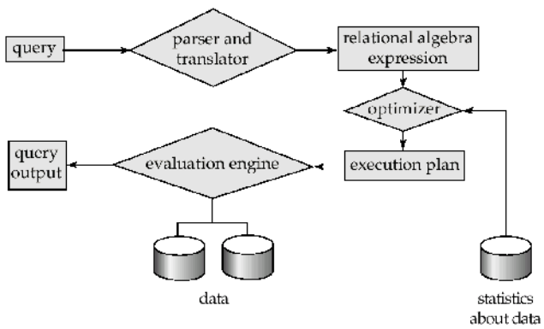
Basic Steps in Query Processing
Parsing and translation
Optimization
Evaluation

Slide 86
Basic Steps in Query Processing
Parsing and translation
translate the query into its internal form.This is then translated into relational algebra.
Parser checks syntax, verifies relations
Evaluation
The query-execution engine takes a query-evaluation plan, executes that plan, and returns the answers to the query.

Slide 87
CREATING INDEXING:-
Indexing is a data structure technique used to find data more quickly and efficiently in a table.
An index is a small table having only two columns. The first column contains a copy of the primary or candidate key of a table and the second column contains a set of pointers holding the address of the disk block where that particular key value can be found. The users cannot see the indexes, they are just used to speed up searches/queries.
Indexes are of 3 types:

Slide 88
INDEXING(CONT.)
. Primary indexes : In primary index, there is a one-to-one relationship between the entries in the index table and the records in the main table. Primary index is defined on an ordered data file. The data file is ordered on a key field. The key field is generally the primary key of the relation.
2. Secondary indexes : Secondary index may be generated from a field which is a candidate key and has a unique value in every record, or a non-key with duplicate values .While creating the index, generally the index table is kept in the primary memory (RAM) and the main table, because of its size is kept in the secondary memory (Hard Disk).
3. Clustering indexes : Clustering index is defined on an ordered data file. The data file is ordered on a non-key field e.g. if we are asked to create an index on a non-unique key, such as Dept-id. There could be several employees in each department. Here we use a clustering index, where all employees belonging to the same Dept-id are considered to be within a single cluster, and the index pointers point to the cluster as a whole.

Slide 89
Thank You

